Slide 2
Operating SYSTEMS aND Systems Programming (CT30A3370) 6 credits
January 17, 2023
Venkata Marella

Slide 3
Chapter 3: Processes
Process Concept
Process Scheduling
Operations on Processes
Cooperating Processes
Interprocess Communication
Communication in Client-Server Systems

Slide 4
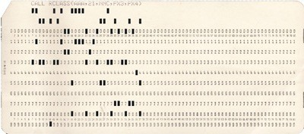
Process Concept
An operating system executes a variety of programs:
Batch system – jobs
Time-shared systems – user programs or tasks
In textbook, job = process
Process – a program in execution using sequential fashion
A process includes:
text section (code)
program counter
stack (function parameters, local vars, return addresses)
data section (global vars)
heap (dynamically allocated memory)
Silberschatz, Galvin Operating System Concepts – 7th Edition and Gagne ©2005
3.4
Silberschatz, Galvin and Gagne ©2005

Slide 5
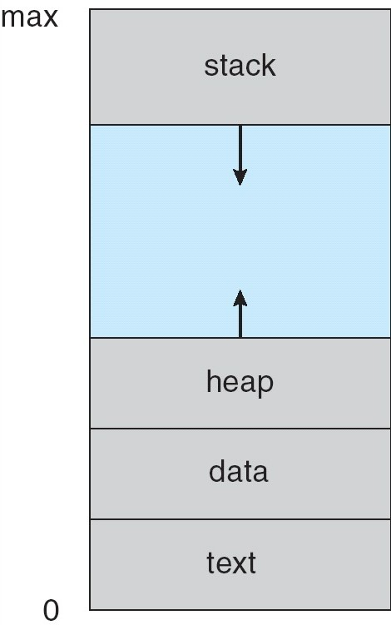
Process in Memory
class A{ public:
const int a = 0;
....
int getValue(){
int[] buffer = new int[1024];
....
delete buffer; return 0;
}
....
}
Silberschatz, Galvin Operating System Concepts – 7th Edition and Gagne ©2005
Notes:
It also includes the current activity, as represented by the value of the program counter
The contents of the processor’s registers. A process generally also includes the process stack, which contains temporary data (such as function
parameters, return addresses, and local variables), and a data section, which contains global variables
A process may also include a heap, which is memory that is dynamically allocated during process run time.

Slide 6
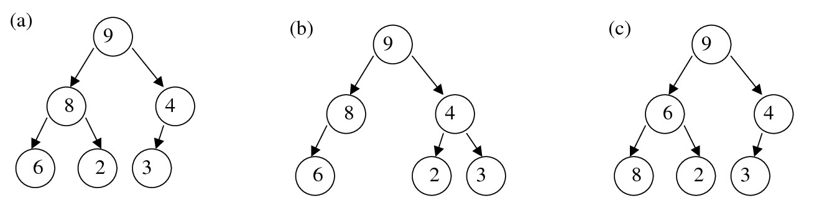
Data Structure: Heap
Heap is a "complete" binary tree
Except the leaf level, all levels are full. The leaf level is filled from left to right
The node's value should be larger/smaller than its children
(a) is a heap
(b) is not for it is not complete,
(c) is not because 6<8
Silberschatz, Galvin Operating System Concepts – 7th Edition and Gagne ©2005

Slide 7
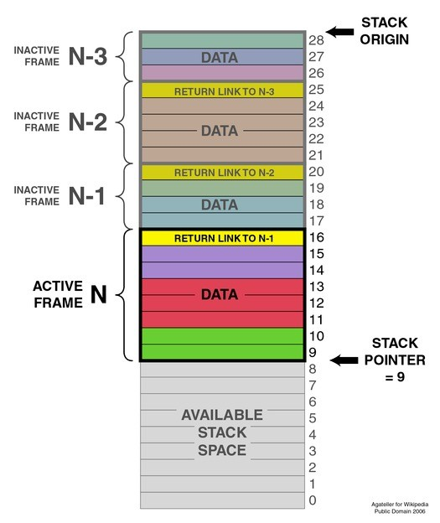
Data Structure: Stack
A typical stack is an area of computer memory with a fixed origin and a variable size.
Initially the size of the stack is zero.
A stack pointer, usually in the form of a hardware register, points to the most recently referenced location on the stack
a push operation, in which a data item is placed at the location pointed to by the stack pointer, and the address in the stack pointer is adjusted by the size of the data item;
a pop or pull operation: a data item at the current location pointed to by the stack pointer is removed, and the stack pointer is adjusted by the size of the data item.
Silberschatz, Galvin Operating System Concepts – 7th Edition and Gagne ©2005

Slide 8
Process State
As a process executes, it changes state
New: The process is being created
Running: Instructions are being executed
Waiting: The process is waiting/blocked for some event to occur
Ready: The process is waiting to be assigned to a processor
Terminated: The process has finished execution
Silberschatz, Galvin Operating System Concepts – 7th Edition and Gagne ©2005
Notes:
New. The process is being created.
• Running. Instructions are being executed.
• Waiting. The process is waiting for some event to occur (such as an I/O
completion or reception of a signal).
• Ready. The process is waiting to be assigned to a processor.
• Terminated. The process has finished execution.

Slide 9
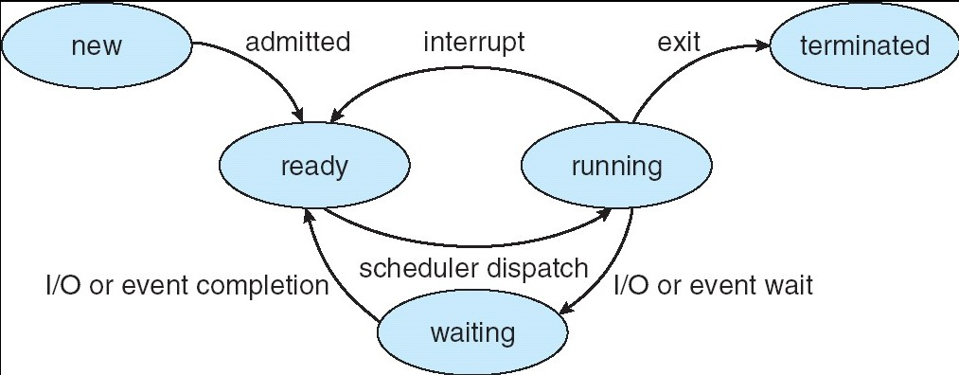
Diagram of Process State
Silberschatz, Galvin Operating System Concepts – 7th Edition and Gagne ©2005

Slide 10
Process Control Block (PCB)
Information associated with each process
Process state (new, ready, ...)
Program counter (address of next instruction)
Contents of CPU registers
CPU scheduling information (priority)
Memory-management information
Accounting information (cpu/time used, time limits, process number)
I/O status information (allocated devices and opened files)
Silberschatz, Galvin Operating System Concepts – 7th Edition and Gagne ©2005
Notes:
Each process is represented in the operating system by a process control block (PCB)—also called a task control block
Process state. The state may be new, ready, running, waiting, terminated, and so on.
Program counter. The counter indicates the address of the next instruction to be executed for this process.
CPU registers. The registers vary in number and type, depending on the computer architecture. They include accumulators, index registers,
stack pointers, and general-purpose registers, plus any condition-code information. Along with the program counter, this state information must
be saved when an interrupt occurs, to allow the process to be continued correctly afterward (Figure 3.4).
CPU-scheduling information. This information includes a process priority, pointers to scheduling queues, and any other scheduling parameters.
Memory-management information. This information may include such items as the value of the base and limit registers and the page tables, or the
segment tables, depending on the memory system used by the operating system (Chapter 8).
Accounting information. This information includes the amount of CPU and real time used, time limits, account numbers, job or process numbers,
and so on.
I/O status information. This information includes the list of I/O devices allocated to the process, a list of open files, and so on.

Slide 11
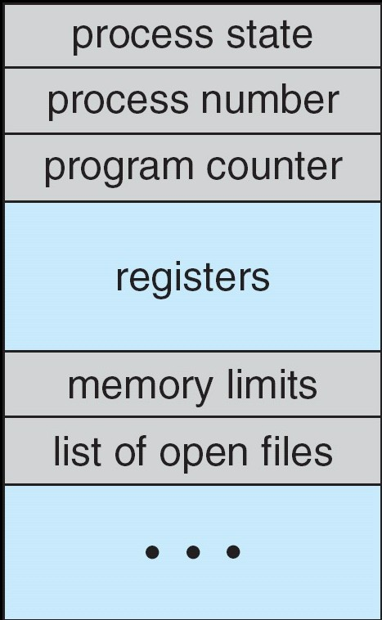
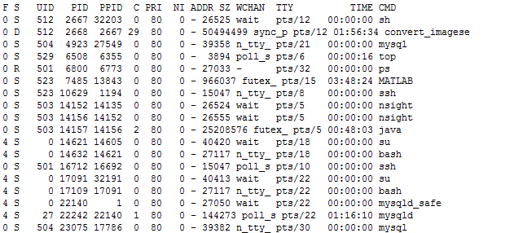
Process Control Block (PCB)
Silberschatz, Galvin Operating System Concepts – 7th Edition and Gagne ©2005

Slide 12
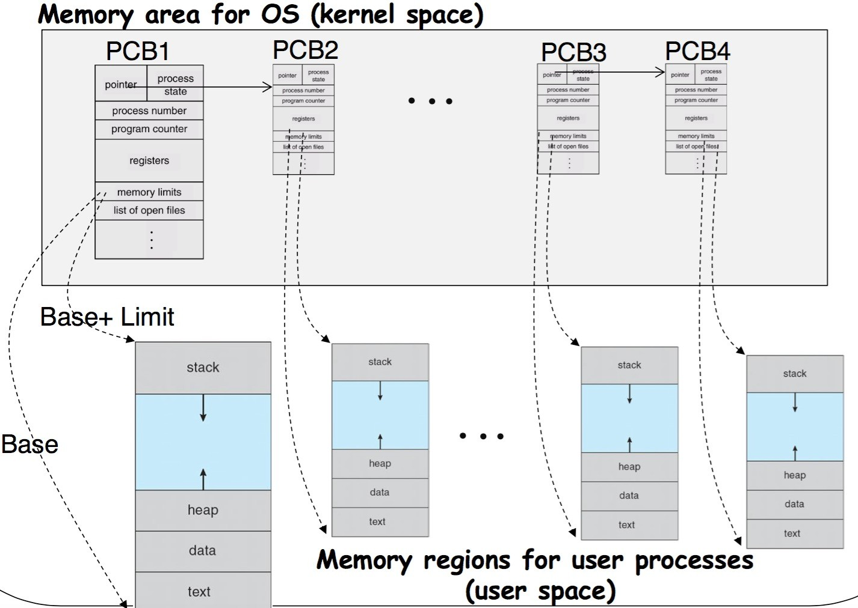

Process Control Block (PCB)
Silberschatz, Galvin Operating System Concepts – 7th Edition and Gagne ©2005

Slide 13
Chapter 3: Processes
Process Concept
Process Scheduling
Operations on Processes
Cooperating Processes
Interprocess Communication
Communication in Client-Server Systems
Notes:
Process Scheduling
The objective of multiprogramming is to have some process running at all times, to maximize CPU utilization. The objective of time sharing is to switch the
CPU among processes so frequently that users can interact with each program
the process scheduler selects an available process (possibly from a set of several available processes) for program execution on the CPU.

Slide 14
Process Scheduling Queues
Job queue – set of all processes in the system
Ready queue – set of all processes residing in main memory, ready and waiting to execute
Device queues – set of processes waiting for an I/O device
Processes migrate among the various queues
1001
1002
1003
1004
1005
Disk: 1002
1001
1003
1005
Network Card: 1004
ready queue
device queue
job queue
Silberschatz, Galvin Operating System Concepts – 7th Edition and Gagne ©2005
Notes:
A modern general-purpose computer system consists of one or more CPUs and a number of device controllers connected through a common bus that
provides access to shared memory
Each device controller is in charge of a specific type of device (for example, disk drives, audio devices, or video displays). The CPU and the device controllers can execute in parallel, competing for memory cycles. To ensure orderly access to the shared memory, a memory controller synchronizes access to the memory. Each device controller is in charge of a specific type of device (for example, disk drives, audio devices, or video displays). The CPU and the device controllers can execute in parallel, competing for memory cycles. To ensure orderly access to the shared memory, a memory controller synchronizes access to the memory.
For a computer to start running—for instance, when it is powered up or rebooted—it needs to have an initial program to run. This initial program,
or bootstrap program, tends to be simple. Typically, it is stored within the computer hardware in read-only memory (ROM) or electrically erasable
programmable read-only memory (EEPROM), known by the general term firmware. It initializes all aspects of the system, from CPU registers to device
controllers to memory content. The bootstrap program must know how to load the operating system and how to start executing that system.
Bootstrap program needs to know where the kernel program of the OS is located and should be loaded into the memory.
Once the kernel is loaded and executing, it can start providing services to the system and its users
Once the kernel is loaded and executing, it can start providing services to
the system and its users. Some services are provided outside of the kernel, by
system programs that are loaded into memory at boot time to become system
processes, or system daemons that run the entire time the kernel is running.
On UNIX, the first system process is “init,” and it starts many other daemons.
Once this phase is complete, the system is fully booted, and the system waits
for some event to occur.

Slide 15
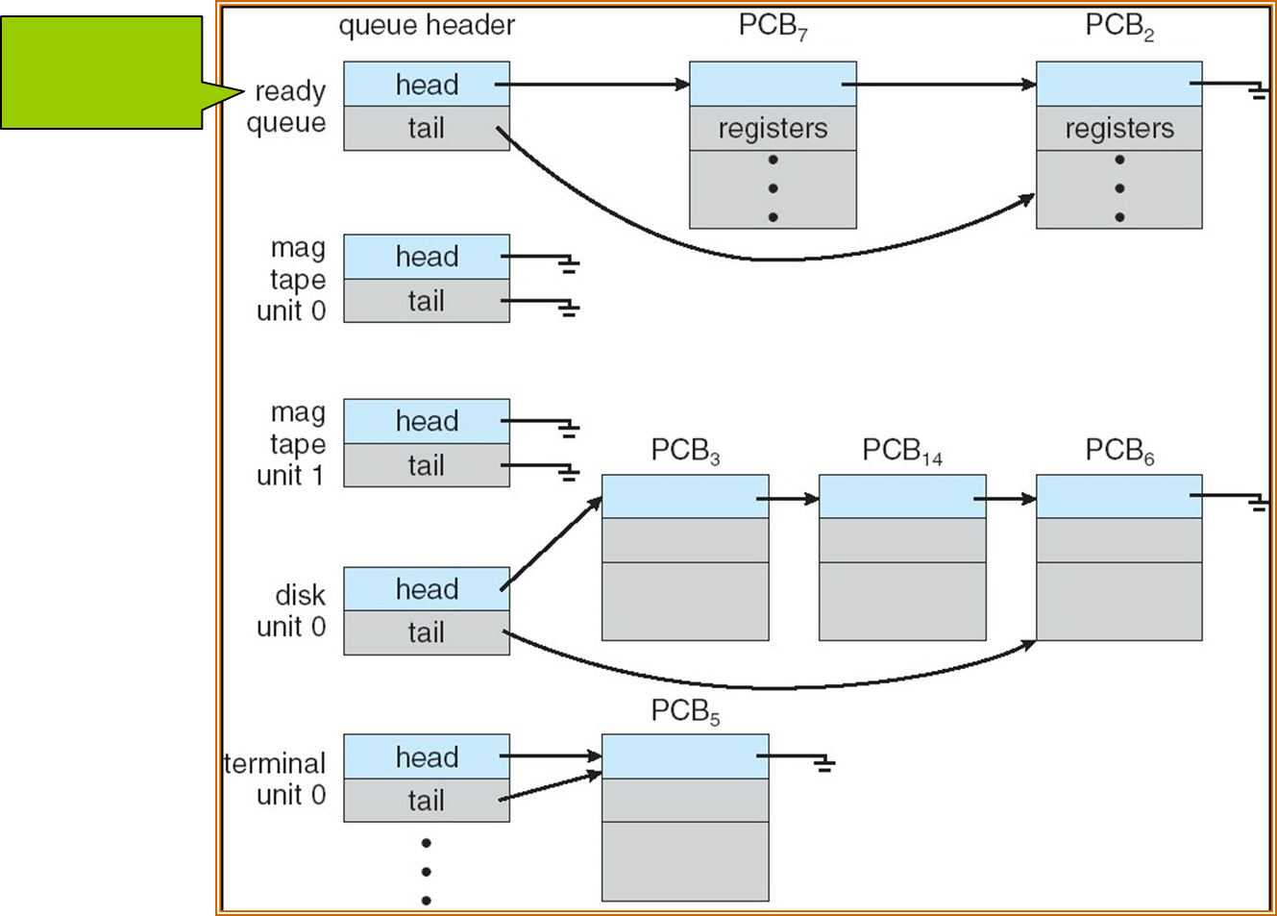
Ready Queue And Various I/O Device Queues
The CPU
queue
Silberschatz, Galvin Operating System Concepts – 7th Edition and Gagne ©2005
Notes:
As processes enter the system, they are put into a job queue, which consists of all processes in the system. The processes that are residing in main memory
and are ready and waiting to execute are kept on a list called the ready queue. This queue is generally stored as a linked list.
A ready-queue header contains pointers to the first and final PCBs in the list. Each PCB includes a pointer field that points to the next PCB in the ready queue.
The list of processes waiting for a particular I/O device is called a device queue.

Slide 16
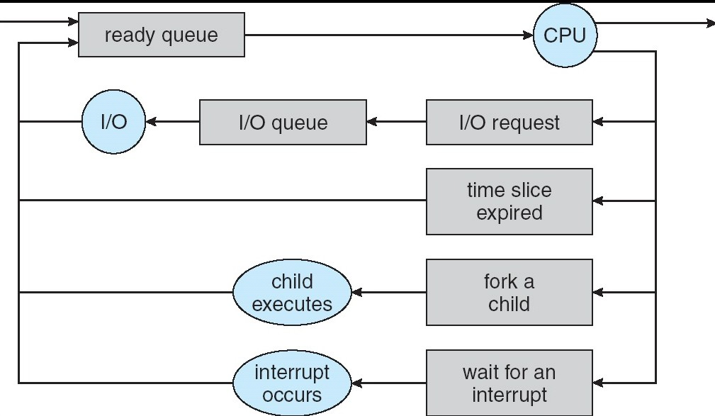
Representation of Process Scheduling
A queueing-diagram
Silberschatz, Galvin Operating System Concepts – 7th Edition and Gagne ©2005
Notes:
Queueing Diagram
Each rectangular box represents a queue. Two types of queues are present: the ready queue and a set of device queues.
The circles represent the resources that serve the queues, and the arrows indicate the flow of processes in the system.
A new process is initially put in the ready queue. It waits there until it is selected for execution, or dispatched.

Slide 17
Schedulers
What is a scheduler? A piece of program
Long-term scheduler (or job scheduler) – selects which processes should be brought into memory (the ready queue)
Short-term scheduler (or CPU scheduler) – selects which process should be executed next and allocates CPU
UNIX and Windows do not use long-term scheduling
Silberschatz, Galvin Operating System Concepts – 7th Edition and Gagne ©2005

Slide 18
Representation of Process Scheduling
Long term scheduler
A queueing-diagram
Short term scheduler
Silberschatz, Galvin Operating System Concepts – 7th Edition and Gagne ©2005

Slide 19


Representation of Process Scheduling
long term scheduling
short term scheduling
Silberschatz, Galvin Operating System Concepts – 7th Edition and Gagne ©2005
Notes:
The process of selecting the process from the queue is called as scheduler.
Often time more processes are submitted for execution that CPU capacity. These processes are stored in mass storage device like disk.
The long-term scheduler, or job scheduler, selects processes from this pool and loads them into memory for execution.
The short-term scheduler, or CPU scheduler, selects from among the processes that are ready to execute and allocates the CPU to one of them.
The long-term scheduler controls the degree of multiprogramming (the number of processes in memory).
An I/O-bound process is one that spends more of its time doing I/O than it spends doing computations.
A CPU-bound process, in contrast, generates I/O requests infrequently, using more of its time doing computations.
A long-term scheduler select a good process mix of I/O-bound and CPU-bound processes.
If all processes are I/O bound, the ready queue will almost always be empty, and the short-term scheduler will have little to do.
The primary distinction between these two schedulers lies in frequency of execution. The short-term scheduler must select a new process for the CPU
frequently. A process may execute for only a few milliseconds before waiting for an I/O request. Often, the short-term scheduler executes at least once every 100 milliseconds. Because of the short time between executions, the short-term scheduler must be fast.
The long-term scheduler executes much less frequently; minutes may separate the creation of one new process and the next.
The long-term scheduler controls the degree of multiprogramming.

Slide 20
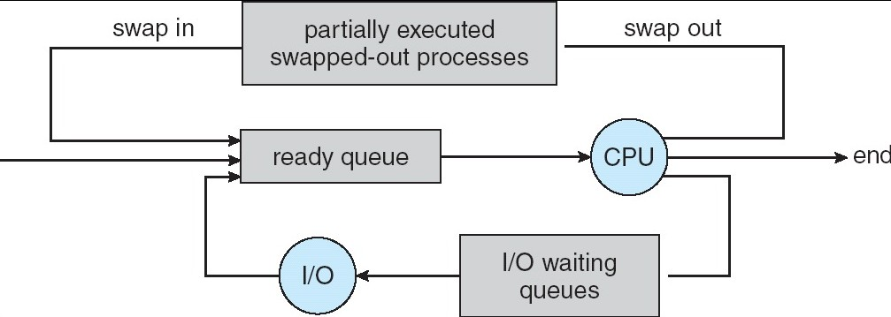
Addition of Medium Term Scheduling
Sometimes, it can be good to swap processes out.
Silberschatz, Galvin Operating System Concepts – 7th Edition and Gagne ©2005
Notes:
The key idea behind a medium-term scheduler is that sometimes it can be advantageous to remove a process from memory
(and from active contention for the CPU) and thus reduce the degree of multiprogramming.
Later, the process can be reintroduced into memory, and its execution can be continued where it left off. This scheme is called swapping

Slide 21
Schedulers (Cont.)
Short-term scheduler is invoked very frequently
(milliseconds) ⇒ (must be fast)
Long-term scheduler is invoked very infrequently
(seconds, minutes) ⇒ (may be slow)
The long-term scheduler controls the degree of multiprogramming
Processes can be described as either:
I/O-bound process – spends more time doing I/O than computations, many short CPU bursts
CPU-bound process – spends more time doing computations; few very long CPU bursts
Need to select good combination of CPU bound and I/O bound processes.
Silberschatz, Galvin Operating System Concepts – 7th Edition and Gagne ©2005

Slide 22
Context Switch
When CPU switches to another process, the system must save the state of the old process and load the saved state for the new process
Context-switch time is overhead; the system does no useful work while switching - typically takes milliseconds
Time dependent on hardware support. In the SPARC architecture, groups of registers are provided.
Silberschatz, Galvin Operating System Concepts – 7th Edition and Gagne ©2005
Notes:
interrupts cause the operating system to change a CPU from its current task and to run a kernel routine.
When an interrupt occurs, the system needs to save the current context of the process running on the CPU so that
it can restore that context when its processing is done, essentially suspending the process and then resuming it.
The context is represented in the PCB of the process.
It includes the value of the CPU registers, the process, and memory-management information.
we perform a state save of the current state of the CPU, be it in kernel or user mode, and then a state restore to resume operations.
Context-switch times are highly dependent on hardware support. For instance, some processors (such as the Sun UltraSPARC) provide multiple sets
of registers. A context switch here simply requires changing the pointer to the current register set.

Slide 23
Chapter 3: Processes
Process Concept
Process Scheduling
Operations on Processes
Cooperating Processes
Interprocess Communication
Communication in Client-Server Systems
Silberschatz, Galvin Operating System Concepts – 7th Edition and Gagne ©2005

Slide 24
Process Creation
Parent process creates children processes, which, in turn create other processes, forming a tree of processes
Resource sharing
Parent and children share all resources
Children share subset of parent’s resources
Parent and child share no resources
Execution
Parent and children execute concurrently
Parent waits until children terminate
Example of Chrome
Silberschatz, Galvin Operating System Concepts – 7th Edition and Gagne ©2005
Notes:
The pid provides a unique value for each process in the system, and it can be used as an index to access various attributes of a process within the kernel.
The init process (which always has a pid of 1) serves as the root parent process for all user processes.
The kthreadd process is responsible for creating additional processes that perform tasks on behalf of the kernel.
The sshd process is responsible for managing clients that connect to the system by using ssh.

Slide 25
Process Creation (Cont.)
Address space
Child duplicate of parent
Child has a program loaded into it
UNIX examples
fork system call creates new process
exec system call used after a fork to replace the process’ memory space with a new program
There are a lot “exec” APIs. For example: execve() execv() execle() execvp() execlp() etc.
Silberschatz, Galvin Operating System Concepts – 7th Edition and Gagne ©2005
Notes:
A new process is created by the fork() system
call. The new process consists of a copy of the address space of the original
process. This mechanism allows the parent process to communicate easily with
its child process.

Slide 26
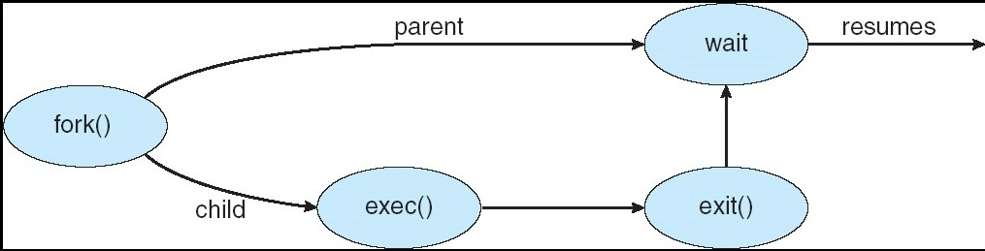
Process Creation
Silberschatz, Galvin Operating System Concepts – 7th Edition and Gagne ©2005
Notes:
A new process is created by the fork() system
call. The new process consists of a copy of the address space of the original
process. This mechanism allows the parent process to communicate easily with
its child process. Both processes (the parent and the child) continue execution
at the instruction after the fork(), with one difference: the return code for
the fork() is zero for the new (child) process, whereas the (nonzero) process
identifier of the child is returned to the parent.

Slide 27
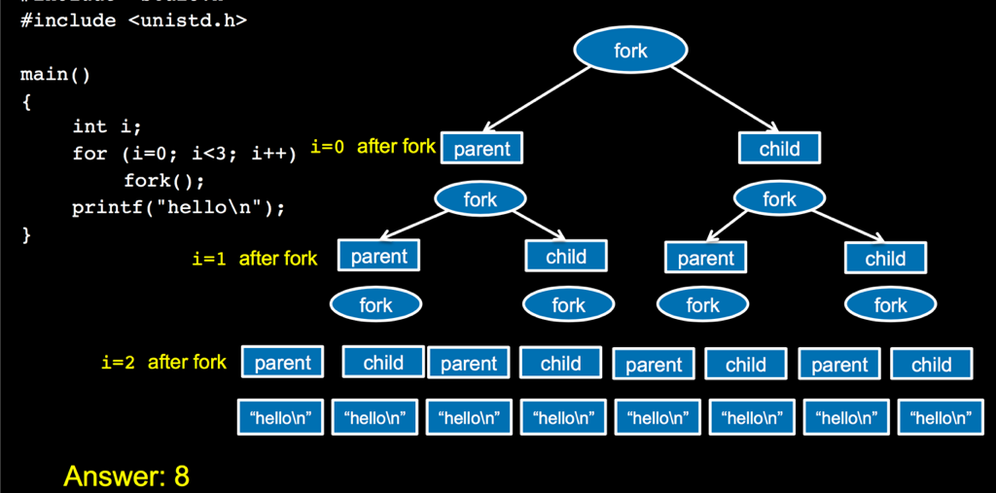
C Program Forking Separate Process
Silberschatz, Galvin Operating System Concepts – 7th Edition and Gagne ©2005

Slide 28
Process Termination
Process executes last statement and asks the operating system to delete it (exit)
Output data from child to parent (via wait)
Process’ resources are deallocated by operating system
Parent may terminate execution of children processes (abort)
Child has exceeded allocated resources
Task assigned to child is no longer required
If parent is exiting
Some operating system do not allow child to continue if its parent terminates
– All children terminated - cascading termination
In some other operating systems, the child gets orphaned
Silberschatz, Galvin Operating System Concepts – 7th Edition and Gagne ©2005
Notes:
A process terminates when it finishes executing its final statement and asks the
operating system to delete it by using the exit() system call.
Some systems do not allow a child to exist if its parent has terminated. In
such systems, if a process terminates (either normally or abnormally), then
all its children must also be terminated. This phenomenon, referred to as
cascading termination, is normally initiated by the operating system.

Slide 29
Chapter 3: Processes
Process Concept
Process Scheduling
Operations on Processes
Cooperating Processes
Interprocess Communication
Communication in Client-Server Systems
Silberschatz, Galvin Operating System Concepts – 7th Edition and Gagne ©2005

Slide 30
Producer-Consumer Problem
Paradigm for cooperating processes, producer process produces information that is consumed by a consumer process
unbounded-buffer places no practical limit on the size of the buffer. Consumer has to wait if no new item.
bounded-buffer assumes that there is a fixed buffer size. Producer must wait if buffer full.
Silberschatz, Galvin Operating System Concepts – 7th Edition and Gagne ©2005
Notes:
A producer process produces information that is consumed by a consumer process. For example, a compiler may produce assembly code that
is consumed by an assembler. The assembler, in turn, may produce object modules that are consumed by the loader.
The unbounded buffer places no practical limit on the size of the buffer. The consumer may have to wait for new items,
but the producer can always produce new items.
The bounded buffer assumes a fixed buffer size. In this case, the consumer must wait if the buffer is empty,
and the producer must wait if the buffer is full.

Slide 31
Bounded-Buffer – Shared-Memory Solution
Shared data
#define BUFFER_SIZE 10 typedef struct {
. . .
} item;
item buffer[BUFFER_SIZE]; int in = 0;
int out = 0;
Solution is correct, but ……
Silberschatz, Galvin Operating System Concepts – 7th Edition and Gagne ©2005
Notes:
The shared buffer is implemented as a circular array with two logical pointers: in and out. The variable
In points to the next free position in the buffer;
Out points to the first full position in the buffer.
The buffer is empty when in == out;
the buffer is full when ((in + 1) % BUFFER SIZE) == out.

Slide 32
Bounded-Buffer – Insert() Method
while (true) {
/* Produce an item */
while (((in + 1) % BUFFER_SIZE ==
out)
; /* do nothing -- no free buffers */ buffer[in] = item;
in = (in + 1) % BUFFER_SIZE;
}
Silberschatz, Galvin Operating System Concepts – 7th Edition and Gagne ©2005
Notes:
The shared buffer is implemented as a circular array with two logical pointers: in and out.
The variable in points to the next free position in the buffer; out
points to the first full position in the buffer.

Slide 33
Bounded Buffer – Remove() Method
while (true) {
while (in == out)
; // do nothing -- nothing to consume
// remove an item from the buffer
item = buffer[out];
out = (out + 1) % BUFFER SIZE;
return item;
}
Silberschatz, Galvin Operating System Concepts – 7th Edition and Gagne ©2005

Slide 34
Round Table
0
9
1
in
8
out
2
3
7
4
6
5
Silberschatz, Galvin Operating System Concepts – 7th Edition and Gagne ©2005

Slide 35
Chapter 3: Processes
Process Concept
Process Scheduling
Operations on Processes
Cooperating Processes
Interprocess Communication
Communication in Client-Server Systems
Silberschatz, Galvin Operating System Concepts – 7th Edition and Gagne ©2005

Slide 36
Interprocess Communication (IPC)
Mechanism for processes to communicate and to synchronize their actions
Models for IPC: message passing and shared memory
Message system – processes communicate with each other without resorting to shared variables
IPC facility provides two operations:
send(message) – message size fixed or variable
receive(message)
If P and Q wish to communicate, they need to:
establish a communication link between them
exchange messages via send/receive
Implementation of communication link
physical (e.g., shared memory, hardware bus)
logical (e.g., logical properties)
Silberschatz, Galvin Operating System Concepts – 7th Edition and Gagne ©2005

Slide 37
Implementation Questions
How are links established?
Can a link be associated with more than two processes?
How many links can there be between every pair of communicating processes?
What is the capacity of a link?
Is the size of a message that the link can accommodate fixed or variable?
Is a link unidirectional or bi-directional?
Silberschatz, Galvin Operating System Concepts – 7th Edition and Gagne ©2005

Slide 38
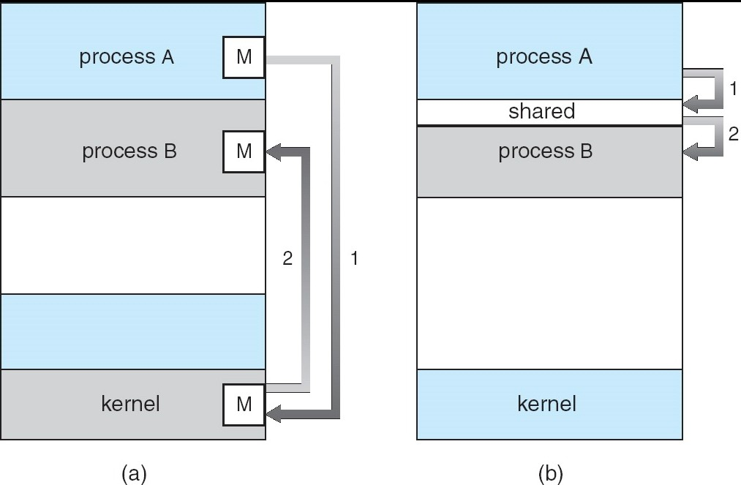
Communications Models
Message passing
Shared memory
Silberschatz, Galvin Operating System Concepts – 7th Edition and Gagne ©2005

Slide 39
Direct Communication
Processes must name each other explicitly:
send (P, message) – send a message to process P
receive(Q, message) – receive a message from process Q
Properties of communication link
Links are established automatically
A link is associated with exactly one pair of communicating processes
Between each pair there exists exactly one link
The link may be unidirectional, but is usually bi- directional
Silberschatz, Galvin Operating System Concepts – 7th Edition and Gagne ©2005

Slide 40
Indirect Communication
Messages are directed and received from mailboxes (also referred to as ports)
Each mailbox has a unique id
Processes can communicate only if they share a mailbox
Properties of communication link
Link established only if processes share a common mailbox
A link may be associated with many processes
Each pair of processes may share several communication links
Link may be unidirectional or bi-directional
Silberschatz, Galvin Operating System Concepts – 7th Edition and Gagne ©2005

Slide 41
Indirect Communication
Operations
create a new mailbox
send and receive messages through mailbox
destroy a mailbox
Primitives are defined as:
send(A, message) – send a message to mailbox A
receive(A, message) – receive a message from mailbox A
Silberschatz, Galvin Operating System Concepts – 7th Edition and Gagne ©2005

Slide 42
Indirect Communication
Mailbox sharing
P1, P2, and P3 share mailbox A
P1, sends; P2 and P3 receive
Who gets the message?
Solutions
Allow a link to be associated with at most two processes
Allow only one process at a time to execute a receive operation
Allow the system to select arbitrarily the receiver. Sender is notified who the receiver was.
Silberschatz, Galvin Operating System Concepts – 7th Edition and Gagne ©2005

Slide 43
Synchronization
Message passing may be either blocking or non-blocking
Blocking is considered synchronous
Blocking send has the sender block until the message is received
Blocking receive has the receiver block until a message is available
Non-blocking is considered asynchronous
Non-blocking send has the sender send the message and continue
Non-blocking receive has the receiver receive a valid message or null
Silberschatz, Galvin Operating System Concepts – 7th Edition and Gagne ©2005

Slide 44
Buffering
Queue of messages attached to the link; implemented in one of three ways
Zero capacity – 0 messages Sender must wait for receiver (rendezvous)
Bounded capacity – finite length of n messages Sender must wait if link full
Unbounded capacity – infinite length Sender never waits
Control of Buffering
Silberschatz, Galvin Operating System Concepts – 7th Edition and Gagne ©2005
Notes:
Zero capacity. The queue has a maximum length of zero; thus, the link cannot have any messages waiting in it. In this case, the sender must block
until the recipient receives the message.
Bounded capacity. The queue has finite length n; thus, at most n messages can reside in it.
UnBounded Capacity: The queue’s length is potentially infinite; thus, any number of messages can wait in it. The sender never blocks.

Slide 45
Chapter 3: Processes
Process Concept
Process Scheduling
Operations on Processes
Cooperating Processes
Interprocess Communication
Communication in Client-Server Systems
Silberschatz, Galvin Operating System Concepts – 7th Edition and Gagne ©2005

Slide 46
Client-Server Communication
Sockets
Remote Procedure Calls
Remote Method Invocation (Java)
Silberschatz, Galvin Operating System Concepts – 7th Edition and Gagne ©2005
Notes:
A socket is defined as an endpoint for communication. A pair of processes communicating over a network employs a pair of sockets—one for each
process. A socket is identified by an IP address concatenated with a port number.

Slide 47
Sockets
A socket is defined as an endpoint for communication
Concatenation of IP address and port
The socket 161.25.19.8:1625 refers to port 1625 on host 161.25.19.8
Communication consists between a pair of sockets
Silberschatz, Galvin Operating System Concepts – 7th Edition and Gagne ©2005

Slide 48
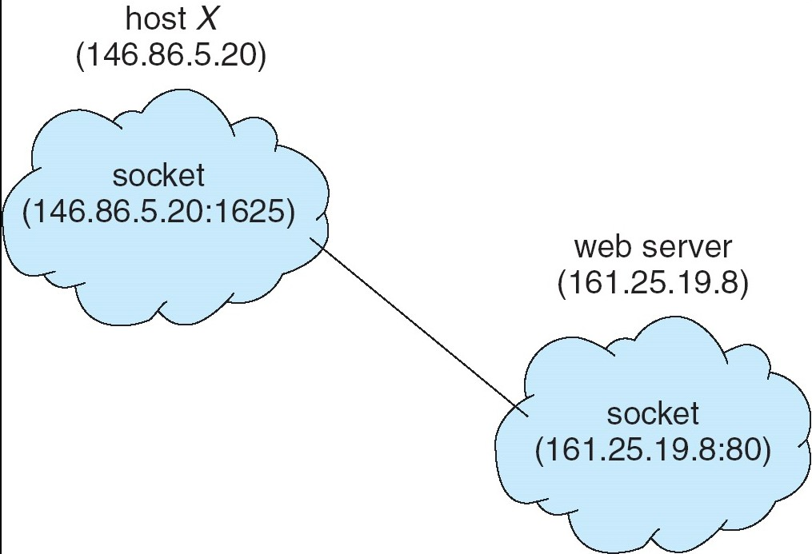
Socket Communication
Silberschatz, Galvin Operating System Concepts – 7th Edition and Gagne ©2005

Slide 49
Remote Procedure Calls
Remote procedure call (RPC) abstracts procedure calls between processes on networked systems.
Stubs – client-side proxy for the actual procedure on the server.
The client-side stub locates the server and marshals the parameters.
The server-side stub receives this message, unpacks the marshaled parameters, and performs the procedure on the server.
Silberschatz, Galvin Operating System Concepts – 7th Edition and Gagne ©2005
Notes:
The semantics of RPCs allows a client to invoke a procedure on a remote
host as it would invoke a procedure locally. The RPC system hides the details
that allow communication to take place by providing a stub on the client side
Parameter marshalling involves packaging the parameters into a form that can be transmitted over
a network. The stub then transmits a message to the server using message
passing. A similar stub on the server side receives this message and invokes
the procedure on the server.

Slide 50
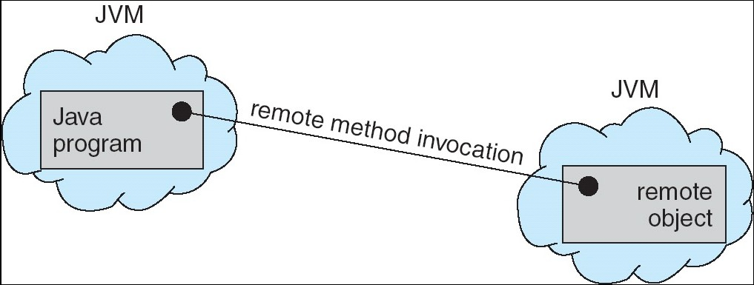
Remote Method Invocation
Remote Method Invocation (RMI) is a Java mechanism similar to RPCs.
RMI allows a Java program on one machine to invoke a method on a remote object.
RMI is object-based
Silberschatz, Galvin Operating System Concepts – 7th Edition and Gagne ©2005

Slide 51
Thank you

